Slide 1
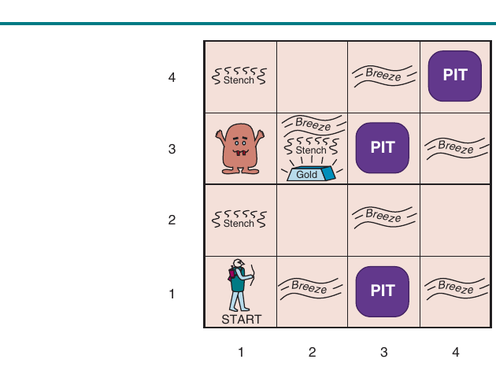
COMP 469
Chapter 7
Logical
Agents
Knowledge bases, propositional logic, inference, SAT solving, and Wumpus World reasoning
Full teaching deck with examples, analogies, gotchas, activities, lab bridges, references, and speaker notes.
CSU Channel Islands | Introduction to AI
01
Notes:
Teaching move: Start by asking, "How does an agent act when it cannot see the whole world but can reason from clues?" That question is Chapter 7. Analogy: Chapter 3 search was like planning a route on a map. Chapter 7 is like being a detective in a dark house: you do not see every room, but you can infer what must be true from clues. Set expectations: Students do not need to become logicians today. They need to understand how AI uses formal symbols plus inference to choose safe actions.

Slide 2
Chapter 7 in One Sentence
Logical agents use explicit knowledge plus inference to choose actions.
Represent
Infer
Act
Store facts about a world as formal sentences instead of only raw program variables.
Derive new facts that were not directly perceived but must follow from what is known.
Use the derived facts to choose safe, goal-directed actions.
COMP 469 | Logical Agents
Chapter 7
02
Notes:
Teaching script: Say, "The agent sees clues, writes them in a formal notebook, asks what must be true, and then acts." That is the chapter in plain English. Analogy: A doctor does not only store symptoms; they infer possible conditions. A logical agent does the same with formal rules. Gotcha: Students may think the knowledge base is a database lookup. Emphasize that a KB can answer questions that were never explicitly stored, because it can infer.

Slide 3
Where Chapter 7 Fits in COMP 469
From atomic states to factored/structured reasoning.
Earlier chapters
Chapter 7 shift
• Ch. 1-2: agents, environments, rational action
• Ch. 3: search over atomic states
• Ch. 5: search when an opponent responds
• Ch. 6: constraints over variables
• Represent general facts, not just states
• Reason under partial observability
• Separate knowledge from inference
• Prepare for first-order logic in Chapter 8
Search asks: "What path gets me there?" Logic asks: "What must be true?"
The agent needs both skills in realistic AI systems.
COMP 469 | Logical Agents
Chapter 7
03
Notes:
Connect this to prior lectures. In route search, the agent knows the whole map and current city. In Wumpus World, the agent does not know where pits are. It needs reasoning, not just pathfinding. Analogy: Search is GPS. Logic is a detective board with clues and rules. Gotcha: Students may ask, "Why not just use machine learning?" Answer: this chapter is about explicit reasoning, which is valuable when rules, explanations, safety constraints, and proofs matter.

Slide 4
Learning Outcomes
What students should be able to explain and do after this lecture.
Build the agent loop
Read logical notation
• Explain TELL and ASK
• Identify KB, sentences, and axioms
• Describe inference in the loop
• Use propositional symbols
• Interpret connectives
• Explain models and entailment
Trace algorithms
Apply to Wumpus
• Model checking
• Resolution
• Forward/backward chaining
• DPLL and WalkSAT
• Infer safe squares
• Avoid confusing unknown with false
• Plan with SAT-style encodings
COMP 469 | Logical Agents
Chapter 7
04
Notes:
Tell students this lecture is not about memorizing symbols. The goal is fluency: read a rule, explain what it means, and trace how inference uses it. Instructor prompt: Ask students to write one learning outcome in their own words. This helps them personalize the objective. Gotcha: Some students will try to treat every formula as algebra. Remind them formulas talk about truth across possible worlds.

Slide 5
Lecture Roadmap
A student-friendly path through Chapter 7.
1. Knowledge-based agents
4. Propositional logic
TELL, ASK, KB, inference, and why this is more flexible than search alone.
Symbols, connectives, truth tables, and a Wumpus knowledge base.
2. Wumpus World
5. Inference algorithms
A small grid world that forces the agent to reason under partial observability.
Model checking, theorem proving, resolution, Horn clauses, chaining.
3. Logic basics
6. SAT solving and planning
Syntax, semantics, models, entailment, soundness, and completeness.
DPLL, WalkSAT, SATPLAN, logical state estimation, and limits.
Everything else is machinery to make this possible.
Core theme: A logical agent acts by proving what follows from what it knows.
COMP 469 | Logical Agents
Lecture Roadmap
05
Notes:
Use this slide to keep students oriented. Chapter 7 has many symbols; students often lose the forest for the trees. Repeat the core theme: a logical agent does not merely remember percepts; it uses inference to derive new facts and then act. Gotcha to preview: In logic, "unknown" is not the same as "false." This matters throughout the Wumpus example.

Slide 6
SECTION 1
Knowledge-Based Agents
Agents that explicitly represent what they know and reason from it.
Knowledge base
Inference
Action
A set of formal sentences about the world.
A method for deriving new sentences from old ones.
Choose actions based on what the KB entails.
COMP 469 | CSU Channel Islands
06
Notes:
Frame this section as a redesign of the agent from Chapter 2. Instead of hardcoding every behavior, we let the agent store knowledge and reason with it. Analogy: A KB agent is like a student with a notebook and a rulebook. The notebook records facts; the rulebook lets the student infer consequences. Gotcha: A sentence in this chapter is not a natural-language English sentence. It is a formal object in a representation language.

Slide 7
From Search Agents to Logical Agents
Why Chapter 7 expands the agent toolkit.
Problem-solving/search agents
Knowledge-based agents
• Know actions and results for states
• Often use atomic state descriptions
• Plan paths to goal states
• Limited at representing general facts
• Store general facts and rules
• Reason over partial information
• Can be told new knowledge
• Can answer new questions from old facts
A search agent can find a route; a logical agent can infer that a route is impossible.
Reasoning adds explanatory power.
COMP 469 | Logical Agents
Chapter 7
07
Notes:
Use a simple route analogy: A search agent can find paths on a map, but it may not know a general rule like "roads cannot have negative length" unless that is encoded procedurally. Analogy: Search is following a recipe. Logic is understanding food safety rules that apply to many recipes. Gotcha: Search is not obsolete. Logical agents often still use search internally, especially for planning.

Slide 8
The KB-Agent Loop
The generic knowledge-based agent: perceive, update, infer, act, remember.
Agent cycle
• TELL the KB what was perceived at time t
• ASK the KB what action should be taken
• TELL the KB which action was executed
Knowledge
Base
Percept
TELL
Action
ASK
TELL action
Why the time index matters
• Percepts happen at different times
• Actions change the world
• The agent must distinguish old facts from current facts
TELL adds facts; ASK uses inference; actions are recorded for time.
COMP 469 | Logical Agents
Knowledge-Based Agents
08
Notes:
Teaching script: Walk through one full call to KB-Agent. The key is that the agent records both what it saw and what it did. Analogy: Imagine a lab notebook. You record observations and interventions. Later, you use both to explain the current state. Gotcha: Students often think ASK just retrieves a stored answer. Point out that ASK may do extensive reasoning before returning an action.

Slide 9
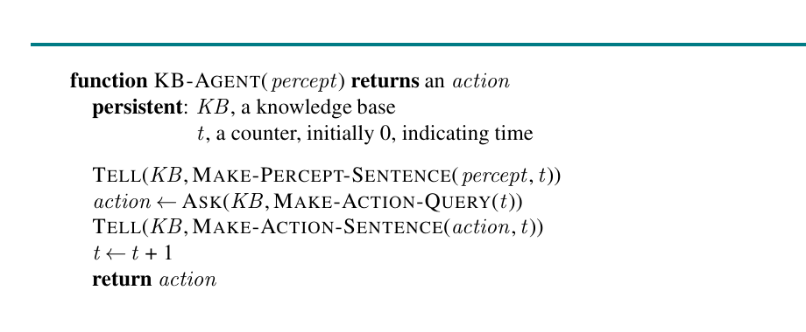
Figure 7.1: Generic KB-Agent
AIMA pseudocode for a knowledge-based agent.
Persistent state
The KB and time counter survive across calls.
TELL percept
The agent converts sensor input into a sentence.
ASK action
The KB is queried for what should be done now.
TELL action
Chapter 7 Figure 7.1: KB-Agent loop
The agent records the action it actually took.
COMP 469 | Logical Agents
Chapter 7 Figures
09
Notes:
Use the figure slowly. Trace the variables: KB is persistent memory; t is not a loop counter in a for-loop, it represents time. Instructor prompt: Ask students, "Why does the agent tell the KB what action it took?" Expected answer: because future reasoning depends on how the agent changed the world. Gotcha: MAKE-PERCEPT-SENTENCE and MAKE-ACTION-SENTENCE hide the representation details. That is good engineering: sensors and actuators are separated from reasoning.

Slide 10
TELL and ASK
The two operations that make a knowledge base useful.
TELL(KB, sentence)
ASK(KB, query)
Inference inside both
Adds a sentence to the KB. Example: "At time 2, I perceived a breeze."
Asks what follows from the KB. Example: "Is square [1,2] safe?"
Adding or asking may trigger derivations from existing sentences.
COMP 469 | Logical Agents
Chapter 7
10
Notes:
Analogy: TELL is adding evidence to a case file. ASK is asking the detective, "Given this case file, what can we prove?" Gotcha: TELL does not make arbitrary statements true in the world. It only records what the agent believes or has been told. If the input is wrong, the KB can reason from wrong premises. Teaching prompt: Ask students to give a TELL sentence and an ASK query for a self-driving car at a stop sign.

Slide 11
Sentences, Axioms, and Knowledge Bases
Key vocabulary before the formulas get heavy.
Sentence
Axiom
A formal assertion in a knowledge representation language.
A sentence accepted as given rather than derived from other sentences.
Knowledge base
Representation language
A collection of sentences the agent can use for inference.
Defines what sentences can be written and what they mean.
COMP 469 | Logical Agents
Chapter 7
11
Notes:
Keep this slide at a high level. Students will see syntax and semantics later; for now, they need the terms. Analogy: The KB is not a pile of English notes. It is more like a spreadsheet with formulas: the structure allows computation. Gotcha: Students sometimes use "fact" and "sentence" interchangeably. A sentence can assert a fact, but the logic also allows complex sentences using AND, OR, NOT, and implication.

Slide 12
Inference: Deriving New Sentences
Inference is the engine that makes knowledge useful.
Old sentences
New sentence
Key requirement
No breeze in [1,1]. A breeze is caused by adjacent pits.
There is no pit in [1,2] and no pit in [2,1].
The inference process should not make things up; answers must follow from the KB.
COMP 469 | Logical Agents
Chapter 7
12
Notes:
Teaching script: This is the first big conceptual milestone. Inference is not guessing. It is deriving what must follow if the KB is true. Analogy: If every CSUCI student has an ID card, and Maya is a CSUCI student, then Maya has an ID card. You did not observe the ID card, but it follows. Gotcha: Inference can be sound and still incomplete, or complete and expensive. We will define those terms soon.

Slide 13
Knowledge Level vs. Implementation Level
Chapter 7 emphasizes what the agent knows, not just how code stores it.
Knowledge level
Implementation level
Why it matters
Describe behavior by what the agent knows and wants.
Actual data structures, algorithms, and code that perform reasoning.
We can discuss rational behavior without committing to one exact implementation.
COMP 469 | Logical Agents
Chapter 7
13
Notes:
Use the automated taxi example: if the taxi knows the Golden Gate Bridge is the only link to Marin County, we expect it to cross the bridge. We do not need to know its neural network or data structure to explain that behavior at the knowledge level. Analogy: You can explain why a calculator shows 4 for 2+2 without knowing the circuit design. Gotcha: Knowledge-level explanations are powerful but not magic. The implementation must still compute the inference somehow.

Slide 14
Example: Advising Bot for COMP 469
A campus-flavored analogy students can understand.
Percepts
KB rules
Student completed COMP 262; student asks about COMP 469.
If prerequisite is complete and seat is available, recommend enrollment.
ASK query
Action
Should the student register for COMP 469 this semester?
Recommend register, waitlist, or take prerequisite first.
COMP 469 | Logical Agents
Chapter 7
14
Notes:
This is a concrete AI advising example. It shows that logical agents are not only for fantasy Wumpus worlds. Ask students: "What would go in the KB?" They may suggest prerequisites, enrollment caps, time conflicts, and degree requirements. Gotcha: This example also shows why first-order logic will be useful later. Propositional logic would require separate symbols for each student, course, and semester.

Slide 15
Knowledge-Based Agent Gotchas
Common early misunderstandings to prevent.
Gotcha 1: KB is not omniscience
Gotcha 2: ASK is not lookup
The agent knows only what it has been told and what follows from it.
The query answer may be inferred even if never explicitly stored.
Gotcha 3: Wrong facts poison reasoning
Gotcha 4: Representation matters
Logic preserves truth only if the premises are accurate.
A clumsy language makes simple facts hard to express.
COMP 469 | Logical Agents
Chapter 7
15
Notes:
Use this as a mini-review before Wumpus World. Analogy: A GPS with a wrong map can produce a perfectly logical but bad route. Sound inference does not save you from false premises. Instructor prompt: Ask, "Can a knowledge base be logically consistent and still factually wrong?" Yes. It can be internally coherent but not match the real world.

Slide 16
SECTION 2
The Wumpus World
A small environment that forces logical reasoning from partial clues.
Hidden dangers
Local percepts
Logical safety
Pits and Wumpus locations are not directly visible.
Breeze, stench, glitter, bump, scream give clues.
The agent should infer which squares are safe before moving.
COMP 469 | CSU Channel Islands
16
Notes:
Frame Wumpus World as a teaching environment, not as a game to memorize. It is small enough to draw but rich enough to require reasoning. Analogy: It is like Minesweeper plus a monster. You do not see mines directly; numbers or clues constrain where hazards can be. Gotcha: Students may want to use probability immediately. Chapter 7 focuses on logic: what must be true, what cannot be true, and what remains unknown.

Slide 17
Wumpus World Rules
The environment assumptions the KB will encode.
Grid world
Hazards
Usually 4x4. Agent starts at [1,1] facing east.
Pits kill the agent. The Wumpus kills the agent if encountered alive.
Gold
Clues
Glitter indicates gold in the current square.
Breeze near pits; stench near Wumpus; bump at wall; scream when Wumpus dies.
COMP 469 | Logical Agents
Chapter 7
17
Notes:
This slide introduces the vocabulary needed for the examples. Do not spend too long on mechanics; emphasize why it is a logic problem. Analogy: It is Minesweeper with actions. The agent must decide whether to step into unknown territory. Gotcha: Breeze and stench are local clues. A breeze does not say which adjacent square has a pit; it only constrains possibilities.

Slide 18
Figure 7.2: A Typical Wumpus World
A compact environment for teaching knowledge-based action.
The agent sees locally
It does not automatically see all pits or the Wumpus.
Clues are relational
A breeze is about adjacent squares, not the current square.
Safety comes from inference
The best action depends on what must be safe.
The map is for us
Chapter 7 Figure 7.2: Wumpus World
The figure shows ground truth for teaching; the agent only gets percepts.
COMP 469 | Logical Agents
Chapter 7 Figures
18
Notes:
Point to the map and say: "We see everything because we are the instructor. The agent does not." This distinction matters. Teaching prompt: Ask students which squares would be risky after the first percept if there is no breeze at the start. Gotcha: Students often interpret the full figure as the agent's knowledge. Keep reminding them: the agent sees only percepts.

Slide 19
Percepts and Actions
What the agent receives and what it can do.
Percept list
Actions
Performance
[Stench, Breeze, Glitter, Bump, Scream]
Move forward, turn left, turn right, grab, shoot, climb.
Get the gold and exit while avoiding death and wasted actions.
COMP 469 | Logical Agents
Chapter 7
19
Notes:
Use the percept list as the bridge from the environment to symbolic sentences. Each percept can become a proposition like Breeze_1,1. Analogy: The agent is wearing a very limited sensor suit. It gets five indicators, not a complete map. Gotcha: A lack of breeze is a percept too. Negative information can be very useful in logic.

Slide 20
First Safety Inference
No breeze at [1,1] rules out adjacent pits.
Given rules
• Breeze in a square iff at least one adjacent square has a pit
• At [1,1], the adjacent squares are [1,2] and [2,1]
• The agent perceives no breeze at [1,1]
PIT
W
Gold
PIT
Breeze
Conclusion
Stench
• No pit in [1,2]
• No pit in [2,1]
• Both adjacent squares are safe from pits
A
Start
Breeze
PIT
Wumpus World = tiny world with hidden hazards and logical clues
COMP 469 | Logical Agents
Wumpus World
20
Notes:
This is the most important Wumpus inference. Do it slowly. Analogy: If a smoke detector only goes off when there is smoke nearby, and it is silent, then nearby locations have no smoke. The absence of a clue can be evidence. Gotcha: This proves no adjacent pit, not no Wumpus. Pit safety and Wumpus safety are separate facts.

Slide 21
From Percept to Sentence
How raw sensor input becomes a logical statement.
Raw percept
Logical sentence
The sensor says: no stench, no breeze, no glitter, no bump, no scream.
NOT Stench_1,1 AND NOT Breeze_1,1 AND NOT Glitter_1,1 ...
Background rule
Derived fact
Breeze_1,1 iff Pit_1,2 OR Pit_2,1.
NOT Pit_1,2 AND NOT Pit_2,1.
COMP 469 | Logical Agents
Chapter 7
21
Notes:
Students may wonder how an agent "understands" a percept. The MAKE-PERCEPT-SENTENCE function translates raw input into a formal representation. Analogy: A thermometer reading becomes a database record like Temp(room42, 71F, 10:03). Raw data becomes a sentence. Gotcha: The translation is designed by us. The reasoning system only manipulates formal sentences after translation.

Slide 22
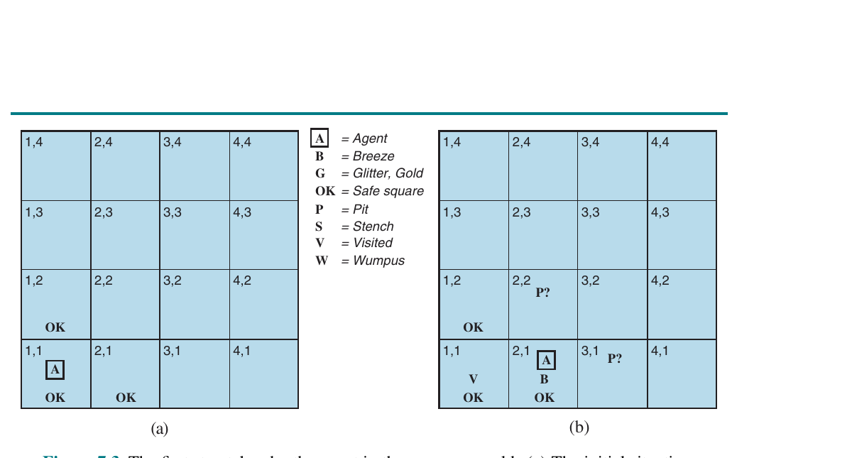
Figure 7.3: First Step Reasoning
The agent begins turning local percepts into safe squares.
Initial square
No breeze means adjacent squares have no pits.
After moving
A breeze at [2,1] introduces pit possibilities.
Possible hazards
The agent marks candidate pit locations instead of guessing.
Reasoning style
Chapter 7 Figure 7.3: Initial situation and first percept after moving
Maintain what is known safe, unsafe, and unknown.
COMP 469 | Logical Agents
Chapter 7 Figures
22
Notes:
Walk students through panel (a) and panel (b). Ask what changed in the KB after the move. Analogy: This is like annotating a Minesweeper board: some cells become safe, some become suspicious, and many remain unknown. Gotcha: A possible pit is not a proven pit. Students often treat P? as P!; prevent that early.

Slide 23
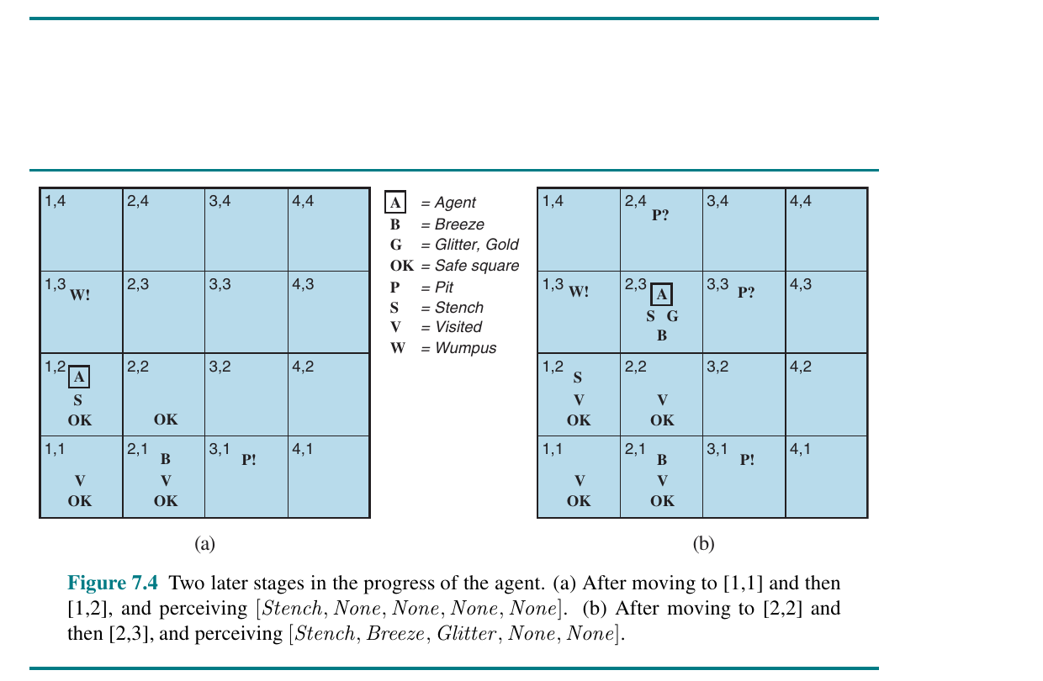
Figure 7.4: Later Wumpus Reasoning
As percepts accumulate, the agent can prove more facts.
More evidence
Each new percept constrains possible worlds.
Proved facts
Some squares become proven safe or proven hazardous.
Goal clue
Glitter gives direct evidence that gold is in the current square.
Teaching point
Chapter 7 Figure 7.4: Later stages in Wumpus World reasoning
Inference accumulates over time.
COMP 469 | Logical Agents
Chapter 7 Figures
23
Notes:
Use this slide to show that the KB gets stronger over time. The agent is not just reacting; it is building a model. Instructor prompt: Ask students to identify one fact the agent knows and one fact it still does not know. Gotcha: Even with logic, the agent may not be able to prove everything. Lack of proof is not proof of falsehood.

Slide 24
Reasoning About Safe Squares
The Wumpus agent constantly asks safety queries.
Ask safe?
If yes
Does KB entail NOT Pit_x,y and NOT Wumpus_x,y?
The square is logically safe given current knowledge.
If no
Risk policy
The square may still be safe; the KB just cannot prove it yet.
The agent design decides whether to wait, infer more, or take a risk.
COMP 469 | Logical Agents
Chapter 7
24
Notes:
This slide introduces an important distinction: logical safety is about proof, not probability. Analogy: In a courtroom, "not proven guilty" is not the same as "proven innocent." Similarly, "not entailed unsafe" is not "entailed safe." Gotcha: Do not let students write "if not KB entails pit, then safe." That is invalid in logic unless the KB entails no pit.

Slide 25
Classroom Activity: Wumpus Clues
Two-minute think-pair-share.
Prompt
Expected answer
Follow-up
At [1,1], the agent perceives no breeze and no stench. Which adjacent squares can be marked safe?
[1,2] and [2,1] are safe from both pits and Wumpus, given the usual adjacency rules.
If the next square has a breeze, what does that prove? What does it only suggest?
COMP 469 | Logical Agents
Chapter 7
25
Notes:
Use this as a quick active-learning break. Let students answer before showing the expected answer. Teaching prompt: Emphasize that "breeze" proves at least one adjacent pit, not exactly which adjacent square contains it. Gotcha: Students may forget boundaries. At [1,1] there are only two adjacent squares, not four.

Slide 26
SECTION 3
Logic: The Language of Knowledge
Formal symbols let agents reason in a domain-independent way.
Syntax
Semantics
Entailment
Which strings count as legal sentences.
What those sentences mean in possible worlds.
What must be true if the KB is true.
COMP 469 | CSU Channel Islands
26
Notes:
Transition line: We have seen why Wumpus needs reasoning. Now we need a formal language for that reasoning. Analogy: Syntax is grammar; semantics is meaning. "Colorless green ideas sleep furiously" has syntax but strange semantics. Gotcha: A string of symbols can be syntactically valid even if it is not true in the current world.

Slide 27
Syntax vs. Semantics
The two halves of any representation language.
Syntax
Semantics
Why students care
Rules for building legal sentences. Example: P AND Q is legal; AND P Q may not be.
Rules that determine whether a sentence is true or false in a model.
Code can check syntax, but reasoning needs semantics.
COMP 469 | Logical Agents
Chapter 7
27
Notes:
Analogy: In Python, syntax says whether code parses; semantics says what happens when it runs. Logic has the same split. Ask: "Is x = = 5 valid Python syntax?" Then ask: "Is x == 5 true?" Different questions. Gotcha: Students may say a formula "means" something based on English intuition. In formal logic, semantics is defined precisely by models.

Slide 28
Models and Possible Worlds
A model assigns truth values to proposition symbols.
Possible world
• A complete assignment of truth values
• Example: Pit_1,2 is false; Pit_2,1 is false; Breeze_1,1 is false
• A sentence is true or false in each model
Set-of-worlds intuition
• A KB rules out worlds inconsistent with evidence
• Inference asks what is true in all remaining worlds
• The agent acts only from what survives every possible world
COMP 469 | Logical Agents
Logic Basics
28
Notes:
This is a major abstraction. A model is a complete way the world could be, relative to the vocabulary. Analogy: Imagine every possible suspect story in a mystery. Evidence eliminates stories. What remains true in every surviving story is entailed. Gotcha: In propositional logic, models are finite only because the vocabulary is finite. With n symbols, there are 2^n models.

Slide 29
Entailment
KB entails alpha when alpha is true in every model where KB is true.
Plain English
• If the KB is true, alpha cannot be false
• Alpha follows from the KB
• There is no counterexample model
Models where KB is true
Models where α is true
Formal notation
• KB entails alpha is written KB ⊨ α
• This is a relationship between sentences
• Do not confuse ⊨ with the implication connective ⇒
KB entails α only if every KB-world is inside α-world.
COMP 469 | Logical Agents
Logic Basics
29
Notes:
Give the courtroom analogy: The evidence entails a conclusion only if every story consistent with the evidence includes that conclusion. Ask students: "If the KB does not entail alpha, does that mean alpha is false?" Answer: no. It may be unknown. Gotcha: Entailment is semantic. It is about truth across models, not about which proof algorithm we happen to run.

Slide 30
Soundness and Completeness
How we judge inference algorithms.
Sound
Complete
Why it matters
If the algorithm derives alpha, alpha is truly entailed. It does not lie.
If alpha is entailed, the algorithm can derive it. It does not miss truths.
AI systems need trustworthy conclusions, not just fast guesses.
COMP 469 | Logical Agents
Chapter 7
30
Notes:
Analogy: A sound detective never accuses an innocent person based on invalid reasoning. A complete detective eventually finds every conclusion that the evidence supports. Gotcha: Sound does not mean complete. Complete does not mean fast. We often trade efficiency against guarantees. Teaching prompt: Ask students whether a cautious algorithm that says "unknown" for everything is sound. Yes, but useless and incomplete.

Slide 31
Propositional Logic: The Simplest Logic We Use
Chapter 7 focuses on proposition symbols and connectives.
Symbols
Connectives
Atomic propositions such as P_1,2 or Breeze_1,1.
NOT, AND, OR, implication, biconditional.
Truth values
Limitation
Each proposition is true or false in a model.
No variables, objects, or quantifiers yet. That comes in Chapter 8.
COMP 469 | Logical Agents
Chapter 7
31
Notes:
Keep this grounded. A proposition symbol is just a named statement that can be true or false. Analogy: A light switch. Each atomic proposition is on or off in a given model. Gotcha: The symbol P_1,2 is atomic to the logic even though humans see coordinates inside the name. Propositional logic does not understand the structure of the name.

Slide 32
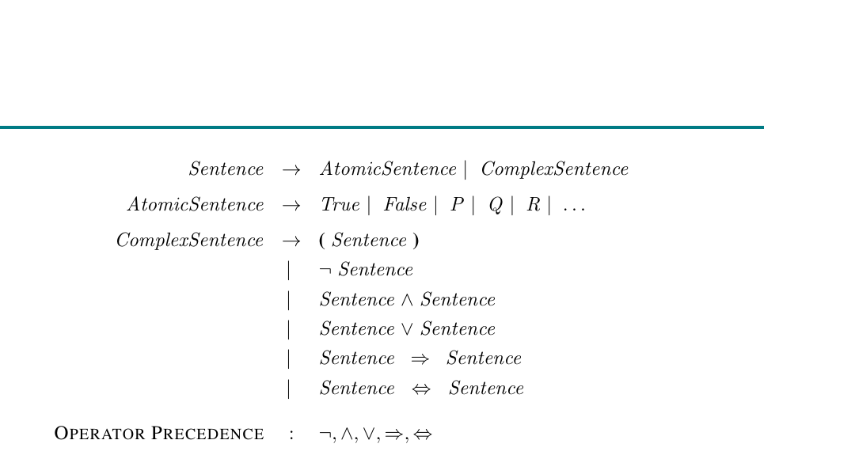
Figure 7.7: Propositional Syntax
A formal grammar defines legal sentences.
Atomic sentence
A proposition symbol such as P or Q.
Complex sentence
Built recursively using connectives.
Precedence
Parentheses and operator precedence prevent ambiguity.
Teaching point
Chapter 7 Figure 7.7: BNF-style grammar for propositional logic
Logic is a formal language, like Python or SQL.
COMP 469 | Logical Agents
Chapter 7 Figures
32
Notes:
Do not require students to memorize BNF. The point is that logic has a precise syntax. Analogy: Programming languages have grammars; propositional logic has one too. Gotcha: Parentheses matter. P OR Q AND R is not necessarily the same as (P OR Q) AND R.

Slide 33
Connectives and Truth Intuition
The five most important operators.
Core connectives
P
Q
P => Q
• NOT P: P is false
• P AND Q: both are true
• P OR Q: at least one is true
• P ⇒ Q: if P then Q
• P ⇔ Q: same truth value
T
T
T
T
F
F
F
T
T
Student-friendly analogies
F
F
T
• AND = both requirements met
• OR = at least one door is open
• Implication = a promise
• Biconditional = a two-way rule
Implication is false only when the promise is broken: P true, Q false.
COMP 469 | Logical Agents
Propositional Logic
33
Notes:
Use simple everyday examples. "If you submit the exam, then it must be before the deadline" is an implication. Gotcha: OR is inclusive in propositional logic. P OR Q allows P true, Q true, or both true. Gotcha: Implication has the weird row: false premise makes the implication true. Explain it as a promise: if I never trigger the condition, I did not break the promise.

Slide 34
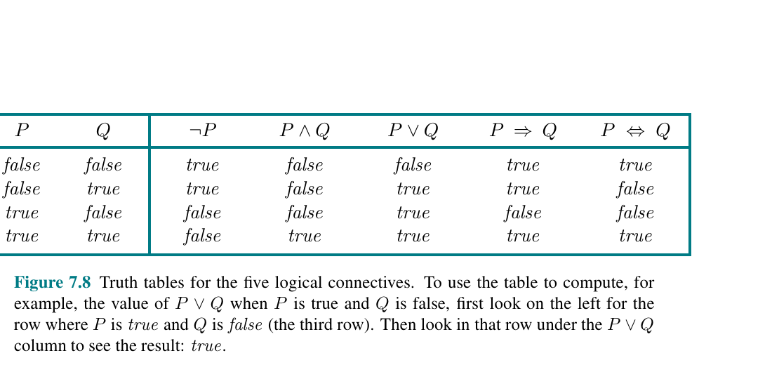
Figure 7.8: Truth Tables
Truth tables define the semantics of connectives.
Rows are models
Each row is one possible truth assignment.
Columns are sentences
Evaluate complex sentences from simpler parts.
Implication row
P ⇒ Q is false only when P is true and Q is false.
Use in algorithms
Chapter 7 Figure 7.8: Truth tables for logical connectives
Model checking is truth-table reasoning at scale.
COMP 469 | Logical Agents
Chapter 7 Figures
34
Notes:
Have students identify the false row for implication. This is a frequent exam gotcha. Analogy: Each row is a possible world. Truth tables are tiny universes enumerated on paper. Gotcha: Do not let students read P OR Q as exclusive OR. In propositional logic, OR is inclusive unless otherwise stated.

Slide 35
The Implication Gotcha
Why P ⇒ Q feels strange at first.
Promise interpretation
False premise
Logic table
"If it rains, I will bring an umbrella." The promise is broken only if it rains and I do not bring it.
If it does not rain, the promise was not broken, regardless of the umbrella.
That is why False ⇒ True and False ⇒ False are both true.
COMP 469 | Logical Agents
Chapter 7
35
Notes:
This slide is worth including because implication confusion creates many downstream errors. Ask students for their own promise statements. Then test the four truth table rows. Gotcha: English "if" has conversational assumptions. Formal implication is narrower and truth-functional.

Slide 36
A Simple Wumpus KB in Propositional Logic
Encoding background knowledge as sentences.
Example symbol
Example rule
B_1,1 means there is a breeze in square [1,1].
B_1,1 ⇔ (P_1,2 OR P_2,1).
Example percept
Query
NOT B_1,1.
Does KB entail NOT P_1,2?
COMP 469 | Logical Agents
Chapter 7
36
Notes:
This is the first formal Wumpus encoding. Do not overcomplicate it. Analogy: We are translating a natural rule into a machine-checkable contract. Gotcha: The biconditional means both directions: if breeze then adjacent pit; if adjacent pit then breeze. That is stronger than one implication.

Slide 37
SECTION 4
Model Checking
Entailment by enumerating possible worlds.
List models
Filter by KB
Test query
Try all truth assignments for the symbols.
Keep worlds where the KB is true.
If alpha is true in all remaining worlds, KB entails alpha.
COMP 469 | CSU Channel Islands
37
Notes:
Transition: Now that students know what models are, model checking is a direct implementation of entailment. Analogy: Try every possible suspect story. Keep the stories matching the evidence. If every remaining story says the same thing, you can conclude it. Gotcha: Direct model checking is conceptually simple but exponentially expensive.

Slide 38
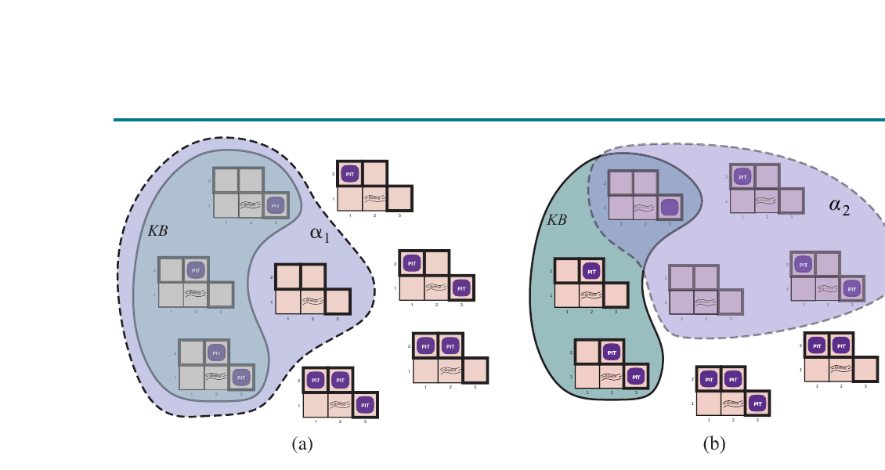
Figure 7.5: Possible Worlds
A visual way to understand entailment in Wumpus World.
Each world
A different placement of hidden pits.
KB filter
Percepts eliminate worlds inconsistent with observations.
Query test
If all KB-compatible worlds agree, the query is entailed.
Key point
Chapter 7 Figure 7.5: Possible models for pit locations
Reasoning is set intersection over possible worlds.
COMP 469 | Logical Agents
Chapter 7 Figures
38
Notes:
Walk the figure as a filtering story. The KB does not pick one world immediately; it narrows possibilities. Analogy: Wordle. Each guess removes possible words. The answer is known only when all remaining possibilities agree. Gotcha: Students may think the agent chooses the most likely world. Model checking in propositional logic is not probabilistic here; it asks what is true in all possible worlds.

Slide 39
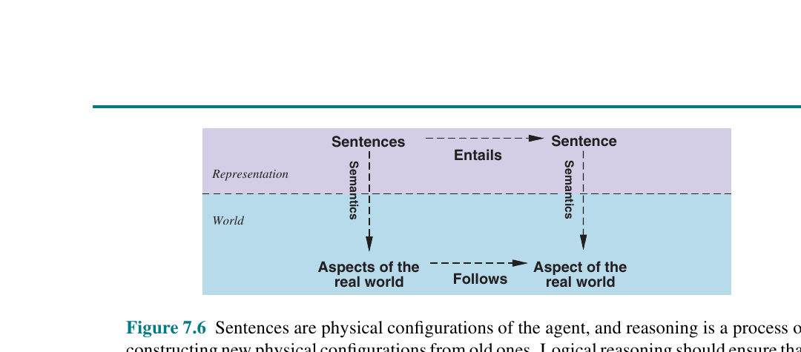
Figure 7.6: Entailment as Models
Entailment is about all worlds where the KB is true.
Sentence = set of models
A sentence is true in some worlds and false in others.
KB = intersection
All sentences in the KB must be true together.
Entailment = containment
The KB worlds are contained in the query worlds.
Powerful image
Chapter 7 Figure 7.6: Sentences as sets of physical configurations
This is the semantic meaning behind logical reasoning.
COMP 469 | Logical Agents
Chapter 7 Figures
39
Notes:
This figure is central. Explain that a sentence carves out a region of possible worlds. Analogy: Filters on an online store. "Blue," "size medium," and "under $50" each remove items. Entailment says every remaining item also has a target property. Gotcha: Students may confuse the arrow direction. If KB entails alpha, the set of KB worlds is a subset of alpha worlds.

Slide 40
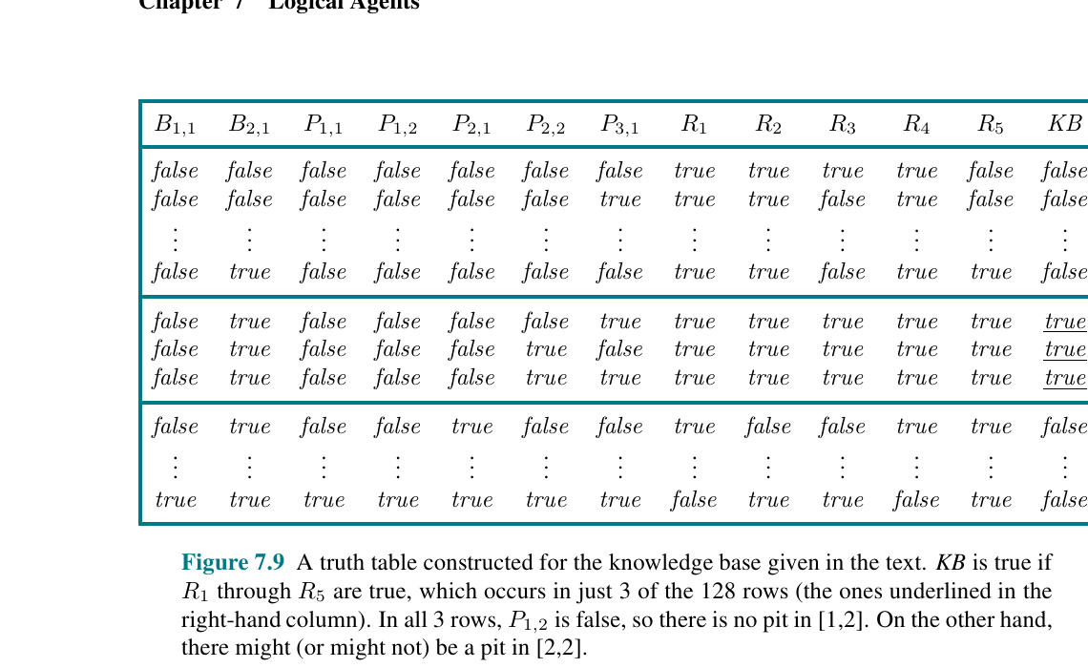
Figure 7.9: Wumpus Truth Table
Model checking for a small Wumpus inference.
Columns
Symbols and derived sentences in the KB.
Rows
Possible assignments of truth values.
Entailment test
Check query in every row where KB is true.
Scaling issue
Chapter 7 Figure 7.9: Truth table for a Wumpus KB and query
More symbols means exponentially more rows.
COMP 469 | Logical Agents
Chapter 7 Figures
40
Notes:
Use this to demystify model checking. It is just truth tables with a purpose. Ask students: "Which rows matter?" Answer: only rows where KB is true. Gotcha: A row where KB is false does not matter for entailment. In a false-KB world, anything can happen relative to the query.

Slide 41
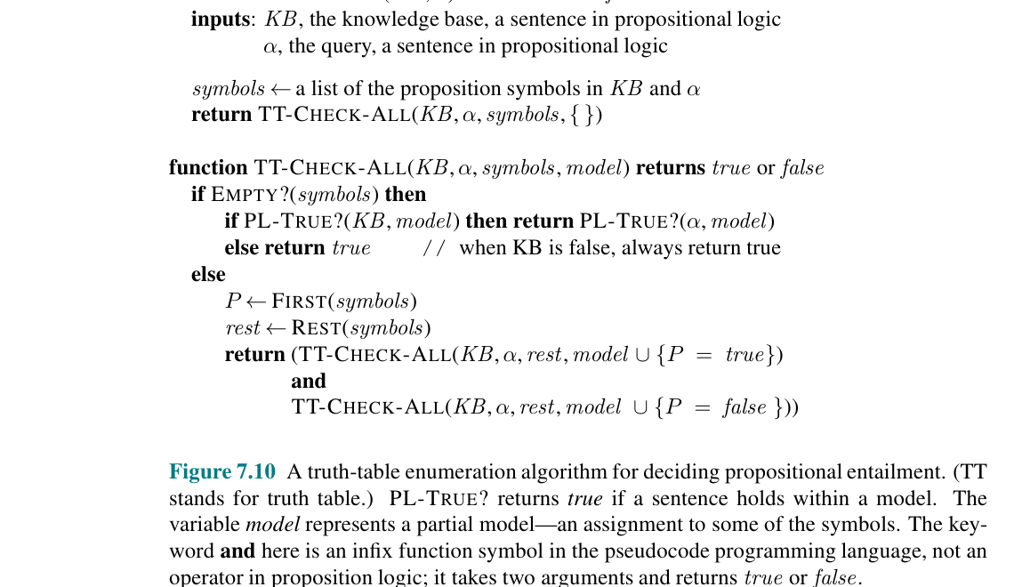
Figure 7.10: TT-ENTAILS?
A recursive algorithm for truth-table entailment.
Depth-first enumeration
Assign each symbol true/false recursively.
Base case
When all symbols are assigned, test KB and query.
Sound and complete
It matches the semantic definition of entailment.
Expensive
Chapter 7 Figure 7.10: Truth-table enumeration algorithm
The number of models grows as 2^n.
COMP 469 | Logical Agents
Chapter 7 Figures
41
Notes:
The algorithm looks technical but the idea is simple: recursively fill in a truth table. Analogy: Trying every combination of switches. With n switches, you have 2^n configurations. Gotcha: Students may miss that model is built incrementally. The recursion avoids storing the entire truth table at once, so space can be small even when time is huge.

Slide 42
Complexity of Model Checking
Conceptually easy does not mean computationally easy.
n symbols
Time
There are 2^n possible models.
Truth-table entailment is exponential in the number of symbols.
Space
Motivation
Recursive depth-first enumeration can use only linear space.
We need smarter algorithms: theorem proving, DPLL, WalkSAT.
COMP 469 | Logical Agents
Chapter 7
42
Notes:
Use a quick calculation: 10 symbols gives 1,024 models; 30 symbols gives over 1 billion. That escalation is the point. Analogy: Combination locks. Adding one more binary dial doubles the possibilities. Gotcha: "Finite" is not the same as "small." The chapter explicitly makes this point.

Slide 43
SECTION 5
Theorem Proving
Derive conclusions by manipulating sentences instead of enumerating worlds.
Proof
Rules
Benefit
A chain of sound inference steps.
Patterns such as modus ponens and resolution.
A short proof can beat huge model enumeration.
COMP 469 | CSU Channel Islands
43
Notes:
Transition: Model checking looks at worlds. Theorem proving looks at sentences. Both can answer entailment, but they operate differently. Analogy: To check a math identity, you can plug in many values, or you can prove it algebraically. Theorem proving is the algebraic route. Gotcha: A proof is only trustworthy if every inference rule is sound.

Slide 44
Model Checking vs. Theorem Proving
Two ways to answer "Does KB entail alpha?"
Model checking
Theorem proving
Enumerate possible worlds and test truth.
Apply inference rules directly to sentences.
When proof wins
When model checking helps
If there are many models but a short proof.
If the vocabulary is small or SAT methods are efficient.
COMP 469 | Logical Agents
Chapter 7
44
Notes:
Analogy: If you want to know whether every route from campus to a destination crosses a bridge, you could inspect every route or use a theorem about the road network. Gotcha: Theorem proving does not mean "guess a proof." Algorithms search through valid proof steps, and that search can still be hard.

Slide 45
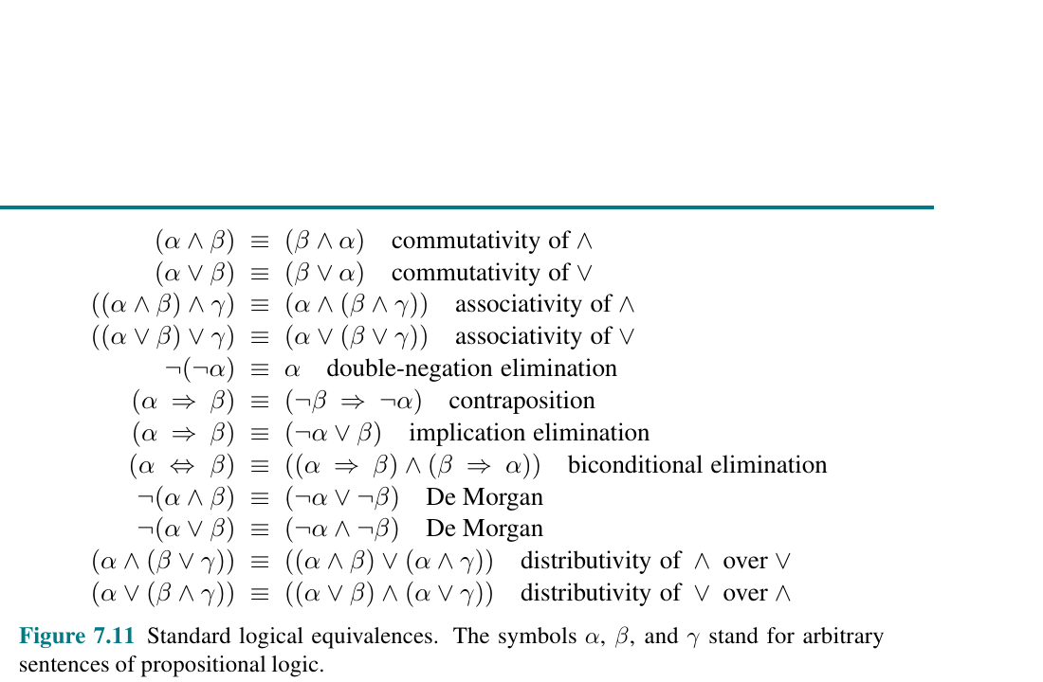
Figure 7.11: Logical Equivalences
Equivalences let us rewrite sentences without changing meaning.
Same models
Equivalent sentences are true in exactly the same worlds.
Like algebra
Rewrite formulas as x+y = y+x style identities.
Used for CNF
Implications and biconditionals can be eliminated.
Student tip
Chapter 7 Figure 7.11: Standard logical equivalences
Use one rewrite at a time and label each step.
COMP 469 | Logical Agents
Chapter 7 Figures
45
Notes:
Use the algebra analogy heavily. Equivalences are logic identities. Teaching prompt: Ask students which equivalence looks like something from algebra: commutativity, associativity, distributivity. Gotcha: The symbol ≡ is a claim about equivalence between sentences. The biconditional ⇔ is a connective inside a sentence.

Slide 46
Validity, Satisfiability, and Unsatisfiability
Three terms that support resolution and SAT solving.
Valid
Satisfiable
True in every model. Like a logical tautology.
True in at least one model.
Unsatisfiable
Entailment connection
True in no models. Contradictory constraints.
KB entails alpha iff KB AND NOT alpha is unsatisfiable.
COMP 469 | Logical Agents
Chapter 7
46
Notes:
This slide is mathematically important. Repeat the last line several times in plain English: to prove alpha, show that denying alpha creates contradiction with the KB. Analogy: If every story consistent with evidence says alpha, then trying to tell a story with not-alpha should fail. Gotcha: Satisfiable does not mean true in the real world. It means there exists at least one model where it is true.

Slide 47
CNF: Conjunctive Normal Form
Resolution works on clauses, so we convert formulas to CNF.
Literal
Clause
A symbol or its negation, such as P or NOT P.
A disjunction of literals, such as P OR NOT Q OR R.
CNF sentence
Why CNF
A conjunction of clauses: clause1 AND clause2 AND ...
Standard form makes resolution and SAT solving systematic.
COMP 469 | Logical Agents
Chapter 7
47
Notes:
Use a food analogy: CNF is like standardizing all recipes into the same template so the cooking machine can process them. Gotcha: Converting to CNF preserves satisfiability/equivalence depending on method, but students should follow the defined rewrite steps carefully. Instructor prompt: Ask students to identify literals, clauses, and the full CNF in a small formula.

Slide 48
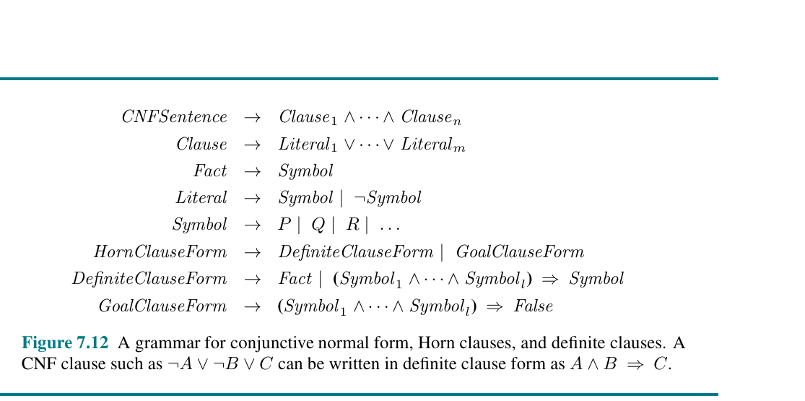
Figure 7.12: CNF Conversion
A grammar-like view of CNF and definite clauses.
CNF shape
AND of OR-clauses.
Definite clause
Exactly one positive literal.
Horn clause
At most one positive literal.
Algorithmic payoff
Chapter 7 Figure 7.12: CNF grammar and definite clauses
Restricted forms enable fast chaining algorithms.
COMP 469 | Logical Agents
Chapter 7 Figures
48
Notes:
Use this slide to introduce Horn clauses gently. We will return to them later. Analogy: CNF is a standardized container format for logical constraints. Gotcha: Do not confuse a Horn clause with any implication. Horn clauses have a specific literal-count restriction that makes inference efficient.

Slide 49
Inference Rules and Proofs
Rules let us create new true sentences from old true sentences.
Modus ponens
AND elimination
From P and P ⇒ Q, infer Q.
From P AND Q, infer P.
Resolution
Proof
From P OR Q and NOT P OR R, infer Q OR R.
A sequence of rule applications ending in the query.
COMP 469 | Logical Agents
Chapter 7
49
Notes:
These are patterns of truth preservation. If the premises are true, the conclusion must be true. Analogy: Inference rules are legal moves in a board game. A proof is a sequence of legal moves from starting facts to a target statement. Gotcha: A rule can be intuitive but invalid. In logic, we only trust rules that are sound.

Slide 50
The Resolution Rule
Resolution is the workhorse rule for complete propositional theorem proving.
Rule pattern
• Clause 1 contains P
• Clause 2 contains NOT P
• Resolve by removing the complementary pair
• Keep the remaining disjunction
Clause 1
Clause 2
P OR Q
NOT P OR R
Cancel complementary literals
Why it proves
• If both clauses are true, the resolvent must be true
• Repeated resolution can derive contradiction
• Contradiction proves entailment by refutation
Resolvent
Q OR R
Like algebra: opposite terms disappear; what remains must still be true.
COMP 469 | Logical Agents
Theorem Proving
50
Notes:
Analogy: Resolution is like canceling opposite terms in algebra, but for clauses. Teach the refutation idea: To prove alpha, assume not alpha and show the assumption crashes into the KB. Gotcha: Resolution operates on clauses in CNF. If students apply it to arbitrary formulas, they will make mistakes.

Slide 51
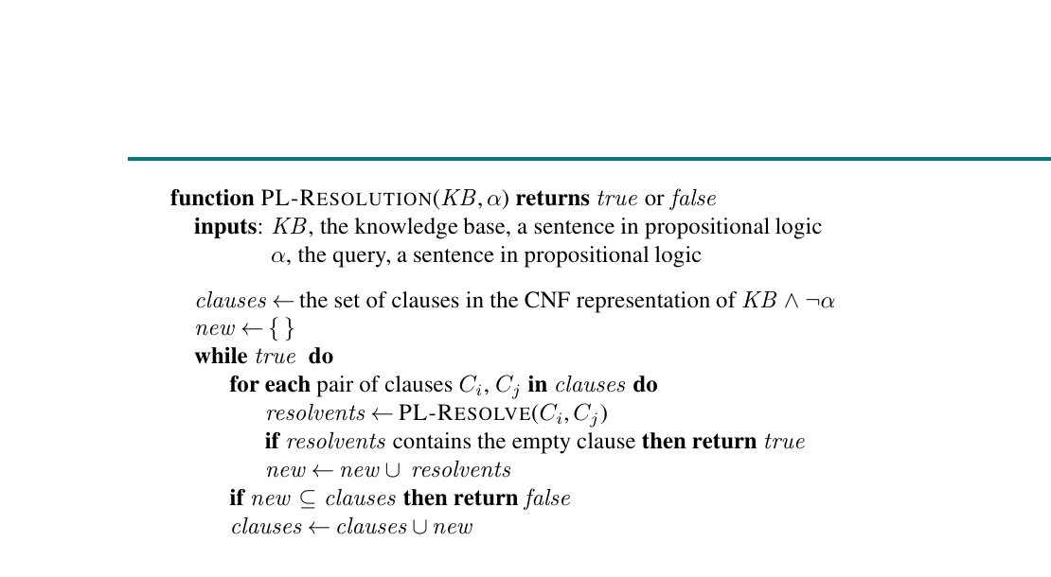
Figure 7.13: PL-RESOLUTION
Proof by contradiction using CNF and the empty clause.
Start
Convert KB AND NOT alpha into CNF clauses.
Loop
Resolve pairs of clauses to produce new clauses.
Success
If the empty clause appears, contradiction found.
Failure
Chapter 7 Figure 7.13: Resolution algorithm
If no new clauses appear, entailment not proven.
COMP 469 | Logical Agents
Chapter 7 Figures
51
Notes:
Use the empty clause idea: a disjunction with no literals cannot be true, so it represents False. Analogy: The assumption not-alpha is like a suspect story. If it forces a contradiction, the story is impossible. Gotcha: The algorithm may generate many useless clauses. Practical provers use many optimizations.

Slide 52
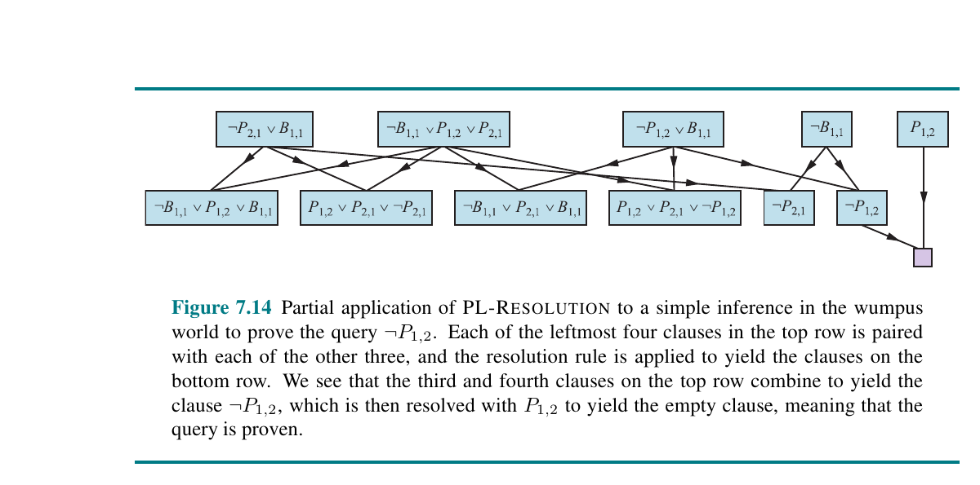
Figure 7.14: Wumpus Resolution Proof
Proving a safe square by deriving contradiction.
Goal
Prove NOT Pit_1,2 from no breeze at [1,1].
Refutation
Assume Pit_1,2 and derive contradiction.
Empty clause
Contradictory unit clauses collapse to False.
Conclusion
Chapter 7 Figure 7.14: Resolution proof for NOT P_1,2
The KB entails NOT Pit_1,2.
COMP 469 | Logical Agents
Chapter 7 Figures
52
Notes:
Walk through the story rather than every symbol. The important message is proof by contradiction. Analogy: If claiming "there is a pit in [1,2]" contradicts the no-breeze rule, then there cannot be a pit there. Gotcha: Students often think proof by contradiction is only math. It is central to automated theorem proving.

Slide 53
Resolution Gotchas
Where students usually make mistakes.
Must be CNF
Complementary literals only
Convert to clauses before resolving.
Resolve P with NOT P, not with unrelated symbols.
Empty clause means contradiction
Do not prove True
It does not mean the KB is empty.
Clauses containing both P and NOT P are tautological and unhelpful.
COMP 469 | Logical Agents
Chapter 7
53
Notes:
This slide is for preventing common homework and exam errors. Teaching prompt: Give students two clause pairs and ask which pair can be resolved. Gotcha: Students sometimes delete both entire clauses. Resolution deletes only the complementary literals and combines the rest.

Slide 54
Horn Clauses and Definite Clauses
Restricted forms that make inference efficient.
Definite clause
Horn clause
A disjunction with exactly one positive literal; often written as premises ⇒ conclusion.
At most one positive literal.
Why useful
AI connection
Entailment with Horn clauses can be decided in time linear in KB size.
Rule systems and logic programming often use Horn-like rules.
COMP 469 | Logical Agents
Chapter 7
54
Notes:
Use the rule form: A AND B => C. That is easier for students than literal-count definitions. Analogy: Horn clauses are like production rules: when all prerequisites are checked off, unlock the conclusion. Gotcha: Horn clauses are less expressive than full propositional logic, but the payoff is speed and simple algorithms.

Slide 55
Forward Chaining
Data-driven inference from facts to consequences.
Start with known facts
Fire rules
Put all known true symbols on an agenda.
When all premises of a rule are known, add its conclusion.
Stop condition
Best use case
Stop when the query appears or no more facts can be inferred.
When many conclusions may be useful from current data.
COMP 469 | Logical Agents
Chapter 7
55
Notes:
Analogy: Dominoes. Known facts knock down rules; rules knock down new facts. Example: If the weather app says rain and the rule says rain implies bring umbrella, forward chaining adds bring umbrella. Gotcha: Forward chaining can infer many facts not relevant to the query. That may be good or wasteful depending on the task.

Slide 56
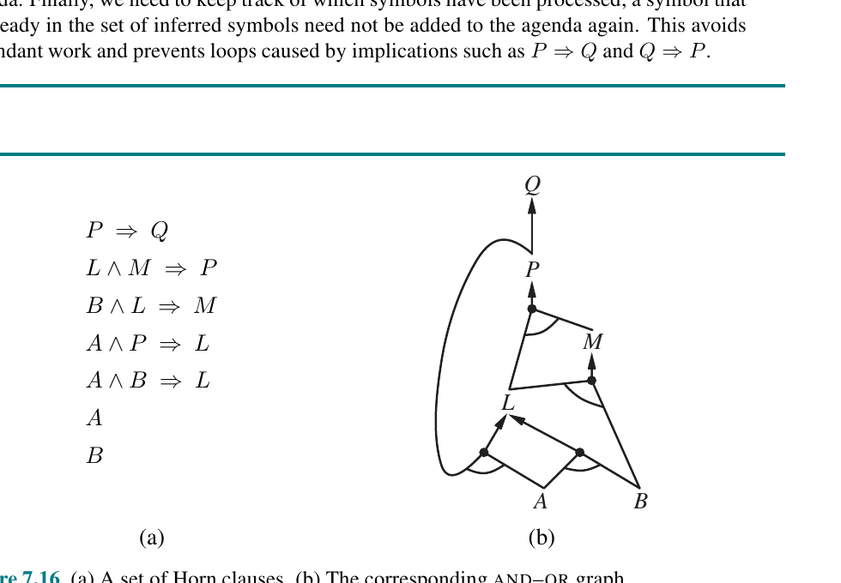
Figures 7.15-7.16: Forward Chaining and Horn Graphs
A rule agenda plus an AND-OR dependency structure.
AND nodes
All premises must be proven before a conclusion fires.
Agenda
Known facts waiting to be processed.
Count table
Tracks how many premises remain for each rule.
Linear time
Chapter 7 Figure 7.16: Horn clauses and corresponding AND-OR graph
With indexing, each rule/premise is processed efficiently.
COMP 469 | Logical Agents
Chapter 7 Figures
56
Notes:
The figure is a good bridge from Chapter 4 AND-OR search to logic. Conjunctions require all children; alternatives provide choices. Teaching prompt: Ask students to trace which facts become known if A and B are initially true. Gotcha: The count table prevents repeatedly scanning every rule from scratch.

Slide 57
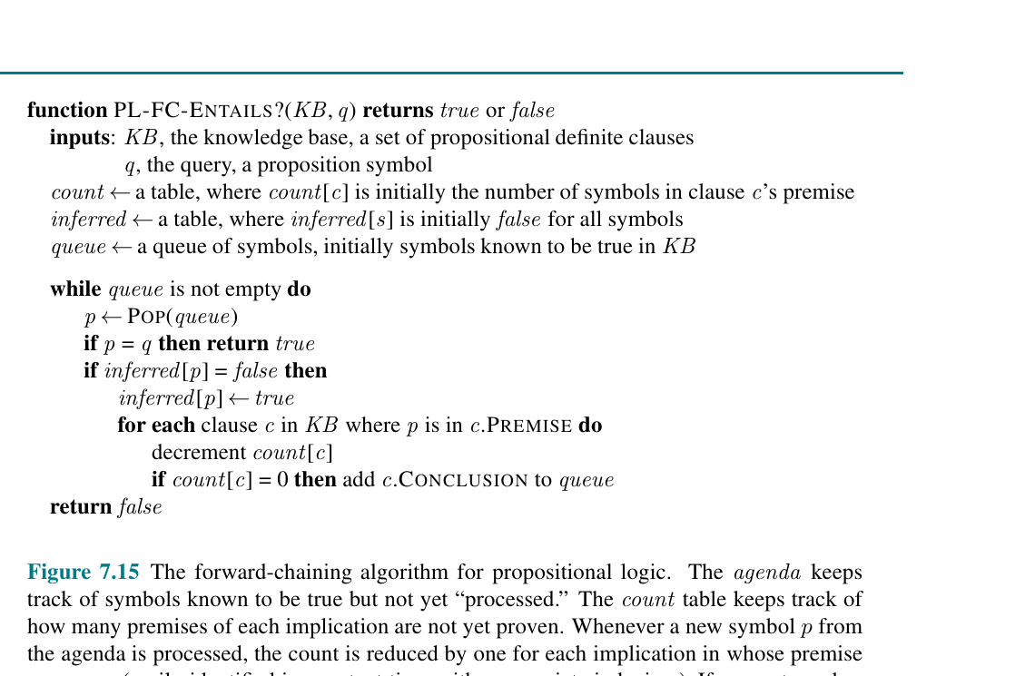
Figure 7.15: PL-FC-ENTAILS?
The algorithmic view of forward chaining.
Queue
Symbols known true but not yet processed.
Inferred table
Avoids repeated work and loops.
Premise counts
When a count hits zero, all premises are known.
Query success
Chapter 7 Figure 7.15: Forward-chaining algorithm
Return true when q is popped from the queue.
COMP 469 | Logical Agents
Chapter 7 Figures
57
Notes:
This slide explains the data structures that make forward chaining efficient. Analogy: A project checklist. When all subtasks are complete, the main task can be marked complete. Gotcha: If students do not track inferred symbols, cyclic rules like P=>Q and Q=>P can cause redundant work or infinite loops.

Slide 58
Backward Chaining
Goal-driven inference from query back to needed facts.
Start with query
Subgoals
Ask what premises would make this query true.
Recursively prove each premise.
Stop at facts
Best use case
If a needed premise is already known, that branch succeeds.
When you only care about one query.
COMP 469 | Logical Agents
Chapter 7
58
Notes:
Analogy: Backward chaining is troubleshooting. If the projector is off, ask: is it plugged in? is the outlet on? is the HDMI selected? Contrast with forward chaining: forward starts with data; backward starts with the goal. Gotcha: Backward chaining can loop without cycle checking, especially in recursive rule sets.

Slide 59
Forward vs. Backward Chaining
Both are useful; choose based on the problem.
Forward chaining
Backward chaining
• Data-driven
• Starts from known facts
• Can derive many conclusions
• Good for monitoring and event-driven systems
• Goal-driven
• Starts from a query
• Proves only what is needed
• Good for diagnosis and query answering
Forward asks: What follows from what I know? Backward asks: What would prove what I want?
Same KB, different reasoning direction.
COMP 469 | Logical Agents
Chapter 7
59
Notes:
Use examples: Forward chaining: sensor network detects smoke and triggers alarms. Backward chaining: help desk asks questions to diagnose why Wi-Fi is down. Gotcha: Students may think one is always better. The choice depends on number of facts, number of queries, and KB structure.

Slide 60
SECTION 6
Effective Propositional Model Checking
SAT algorithms make propositional reasoning practical in many cases.
DPLL
WalkSAT
SATPLAN
Complete backtracking SAT solver with pruning.
Incomplete local search that often finds models quickly.
Planning by asking whether a goal-reaching model exists.
COMP 469 | CSU Channel Islands
60
Notes:
Transition: Truth tables are exponential, but practical SAT algorithms solve many large cases by exploiting structure. Analogy: Brute-force model checking tries every key. SAT algorithms use the lock's structure to avoid most keys. Gotcha: Worst-case exponential complexity remains. Practical success does not mean the complexity barrier disappears.

Slide 61
SAT Problems as Search
A SAT solver searches for a model that makes a formula true.
Input
Output if satisfiable
A propositional formula, usually in CNF.
A truth assignment that satisfies every clause.
Output if unsatisfiable
AI use
No model exists. For complete solvers, this is guaranteed.
Planning, verification, diagnosis, scheduling, hardware/software checking.
COMP 469 | Logical Agents
Chapter 7
61
Notes:
Connect SAT to search from Chapter 3: the states are partial assignments; actions assign symbols; the goal is satisfying all clauses. Analogy: Sudoku as constraints. A solution assigns values that satisfy all rules. Gotcha: SAT asks whether there exists a model. Entailment often becomes SAT by checking unsatisfiability of KB AND NOT query.

Slide 62
DPLL Intuition
DPLL is truth-table enumeration with intelligence.
Main ideas
• Choose an unassigned symbol
• Try true or false recursively
• Stop early when clauses are already satisfied or contradicted
choose P
P = T
P = F
Two key shortcuts
• Pure symbol heuristic: assign symbols that appear with one polarity
• Unit clause heuristic: forced assignments from single-literal clauses
• These prune the search tree
unit
fail
pure
model
DPLL = model checking with early pruning and smart forced choices.
COMP 469 | Logical Agents
SAT Algorithms
62
Notes:
Analogy: DPLL is like solving a logic puzzle. If a clue forces a value, do not guess it; write it down and continue. Gotcha: DPLL is complete. If it says unsatisfiable, it has ruled out every possible assignment via systematic search. Teaching prompt: Ask students why a unit clause is forced. If the clause has only one literal left, that literal must be true to satisfy the clause.

Slide 63
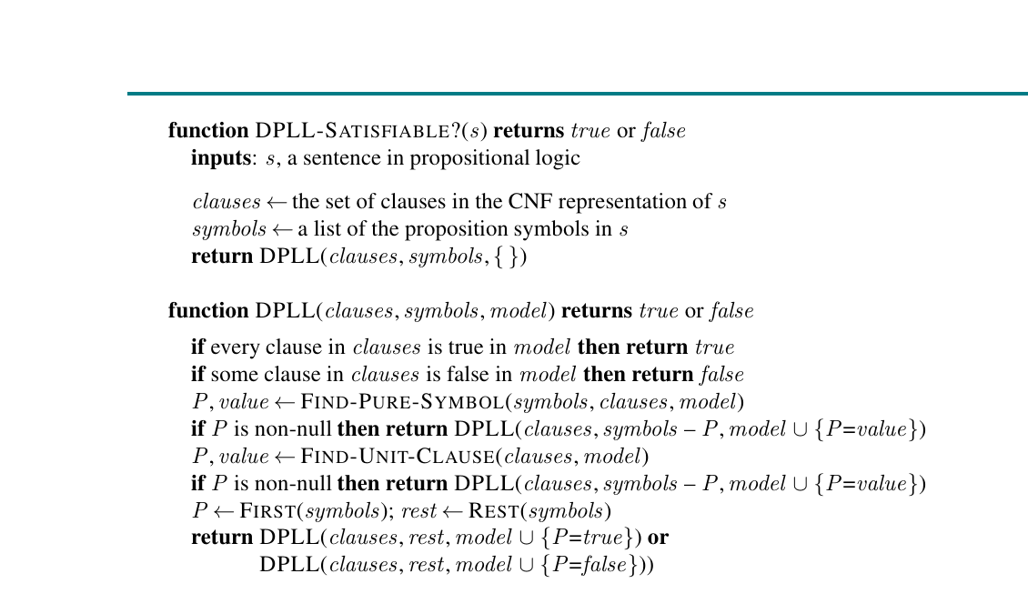
Figure 7.17: DPLL
A complete backtracking SAT algorithm.
Complete
Eventually finds a satisfying assignment or proves none exists.
Model grows
Recursive calls add assignments to the model.
Pruning
Short-circuit true/false clauses and forced symbols.
Modern SAT roots
Chapter 7 Figure 7.17: DPLL algorithm
DPLL is a foundation for many SAT solvers.
COMP 469 | Logical Agents
Chapter 7 Figures
63
Notes:
Trace the algorithm at a high level. Avoid getting lost in the code. Analogy: Branch-and-bound for truth assignments. It cuts off impossible branches early. Gotcha: DPLL returns true/false for satisfiability, but actual implementations often return the satisfying model too.

Slide 64
DPLL Trace Example
Small formula: (P OR Q) AND (NOT P OR R) AND (NOT Q OR R)
Step 1
Step 2
Try P = true. Clause (P OR Q) is satisfied.
Clause (NOT P OR R) becomes R, a unit clause.
Step 3
Model
Set R = true. Remaining clauses become satisfied.
P=true, R=true, Q can be either true or false.
COMP 469 | Logical Agents
Chapter 7
64
Notes:
This example demonstrates unit propagation. Once P is true, the second clause forces R. Ask students: "Did we have to try all 8 assignments for P,Q,R?" No. Gotcha: A satisfying model need not assign every symbol if the remaining choices do not matter. In code, we often complete the model arbitrarily.

Slide 65
WalkSAT Intuition
Local search over truth assignments.
Start randomly
Find an unsatisfied clause
Pick a random complete assignment.
Choose a clause currently false.
Flip a symbol
Repeat
Randomly or greedily flip one variable in that clause.
If a satisfying model appears, return it; otherwise give up after max flips.
COMP 469 | Logical Agents
Chapter 7
65
Notes:
Analogy: WalkSAT is hiking in fog. You start somewhere, look at a violated constraint, and step in a direction that might improve things. Gotcha: WalkSAT is not complete. If it fails, the formula may still be satisfiable; it just did not find a model in time. Instructor prompt: Compare with local search from Chapter 4 if students have seen it.

Slide 66
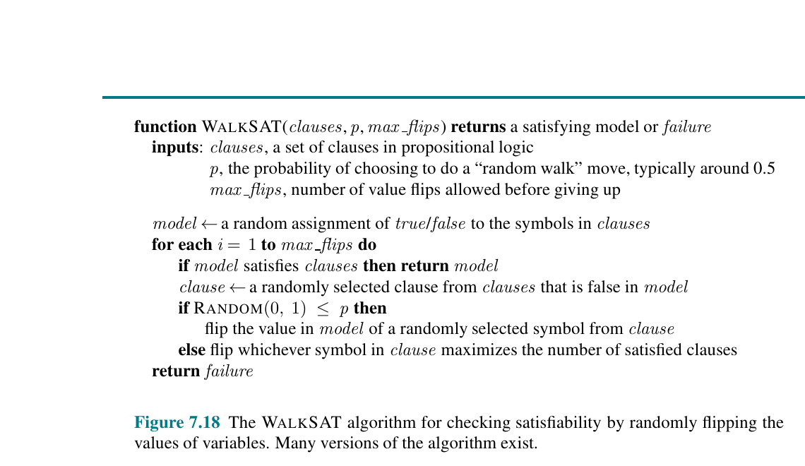
Figure 7.18: WalkSAT
Randomized local search for satisfiability.
Incomplete
Finding a model proves satisfiable; failing does not prove unsatisfiable.
Noise helps
Random flips can escape local minima.
Fast in practice
Often solves large satisfiable instances quickly.
Parameter p
Chapter 7 Figure 7.18: WalkSAT algorithm
Controls random vs. greedy behavior.
COMP 469 | Logical Agents
Chapter 7 Figures
66
Notes:
Explain the role of randomness. Greedy search can get stuck; randomness can shake it loose. Analogy: If you are stuck in a maze, sometimes taking a non-obvious turn helps escape. Gotcha: Students may think randomized means unreliable. It is probabilistic, but it can be extremely useful with restarts and enough time.

Slide 67
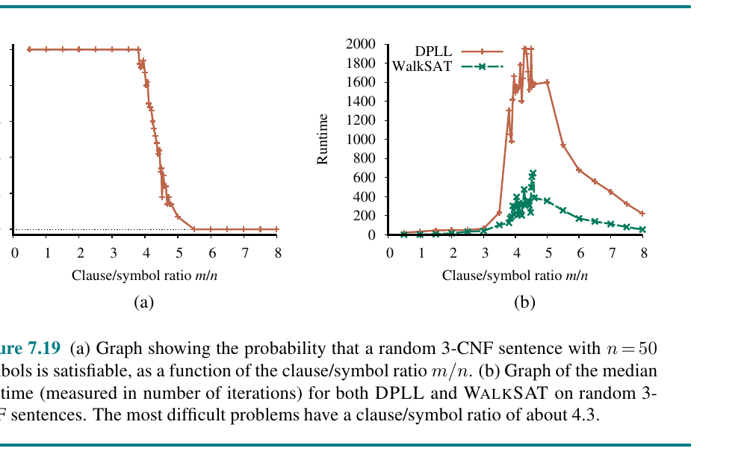
Figure 7.19: Random 3-CNF Landscape
SAT difficulty changes sharply with clause-to-symbol ratio.
Phase transition
Around a critical ratio, random formulas shift from usually satisfiable to usually unsatisfiable.
Hard region
Solvers often struggle near the transition.
DPLL vs WalkSAT
Different algorithms show different runtime patterns.
Teaching point
Chapter 7 Figure 7.19: Probability and runtime for random 3-CNF instances
Problem structure matters as much as size.
COMP 469 | Logical Agents
Chapter 7 Figures
67
Notes:
Use this as an example of algorithm behavior, not a graph to memorize. Analogy: Some puzzles are easy because they have many solutions; some are easy because they are obviously impossible. The hard ones are balanced near the edge. Gotcha: The graph is about random 3-CNF families, not every SAT problem.

Slide 68
DPLL vs. WalkSAT
Different algorithms, different guarantees.
DPLL
WalkSAT
• Complete backtracking search
• Can prove unsatisfiable
• Uses pruning and forced moves
• Good when guarantees matter
• Randomized local search
• Often fast for satisfiable cases
• Cannot prove unsatisfiable by failure alone
• Good for large practical searches with time limits
DPLL gives certainty; WalkSAT gives speed with risk.
Both are useful tools in an AI toolbox.
COMP 469 | Logical Agents
Chapter 7
68
Notes:
Emphasize algorithm selection. We choose based on the need for proof, speed, instance type, and tolerance for uncertainty. Gotcha: If WalkSAT returns a satisfying assignment, that result is sound. The incompleteness is only about failure to find one.

Slide 69
SECTION 7
Agents Based on Propositional Logic
Using logic to track the world and make plans.
State estimation
Hybrid agents
SATPLAN
Maintain a sentence describing possible current states.
Combine logical inference with search/planning routines.
Turn planning into satisfiability.
COMP 469 | CSU Channel Islands
69
Notes:
Transition: We now bring the algorithms back to the agent. The goal is not solving formulas for fun; it is choosing actions. Analogy: The KB is the agent's evolving mental map. The inference engine updates the map; the planner chooses moves. Gotcha: Propositional logic can model time, but it does so by creating many time-indexed symbols. This can grow quickly.

Slide 70
The Current State of the World
Logical agents estimate state from percept history.
Fluents
Static facts
State properties that can change over time, such as At_1,1_t or HasArrow_t.
Rules that do not change, such as adjacency relationships.
Belief state
Update
A logical sentence describing all states still possible.
Use action effects and new percepts to refine the belief state.
COMP 469 | Logical Agents
Chapter 7
70
Notes:
Connect to Chapter 4 if applicable: belief states represent uncertainty about the current state. Here the belief state is represented as a logical sentence. Analogy: A detective's suspect list after each new clue. The list shrinks or changes as evidence and actions accumulate. Gotcha: The actual world is one state; the agent's belief state may describe many possible states.

Slide 71
Successor-State Axioms
Compact rules for what changes and what stays the same.
Problem
Successor-state axiom
The agent needs to know how actions change fluents over time.
A rule specifying when a fluent is true at time t+1.
Frame problem
Teaching analogy
Most things stay unchanged after most actions; representing that naively is expensive.
Like an accounting ledger: record changes, not every unchanged item.
COMP 469 | Logical Agents
Chapter 7
71
Notes:
This is a subtle idea. The agent needs to model both change and persistence. Analogy: If you move your backpack, your laptop, desk, and chair do not all need separate announcements saying they stayed put. Good representations avoid listing every non-change. Gotcha: Students may think only action effects matter. Non-effects matter too because the agent must know what persists.

Slide 72
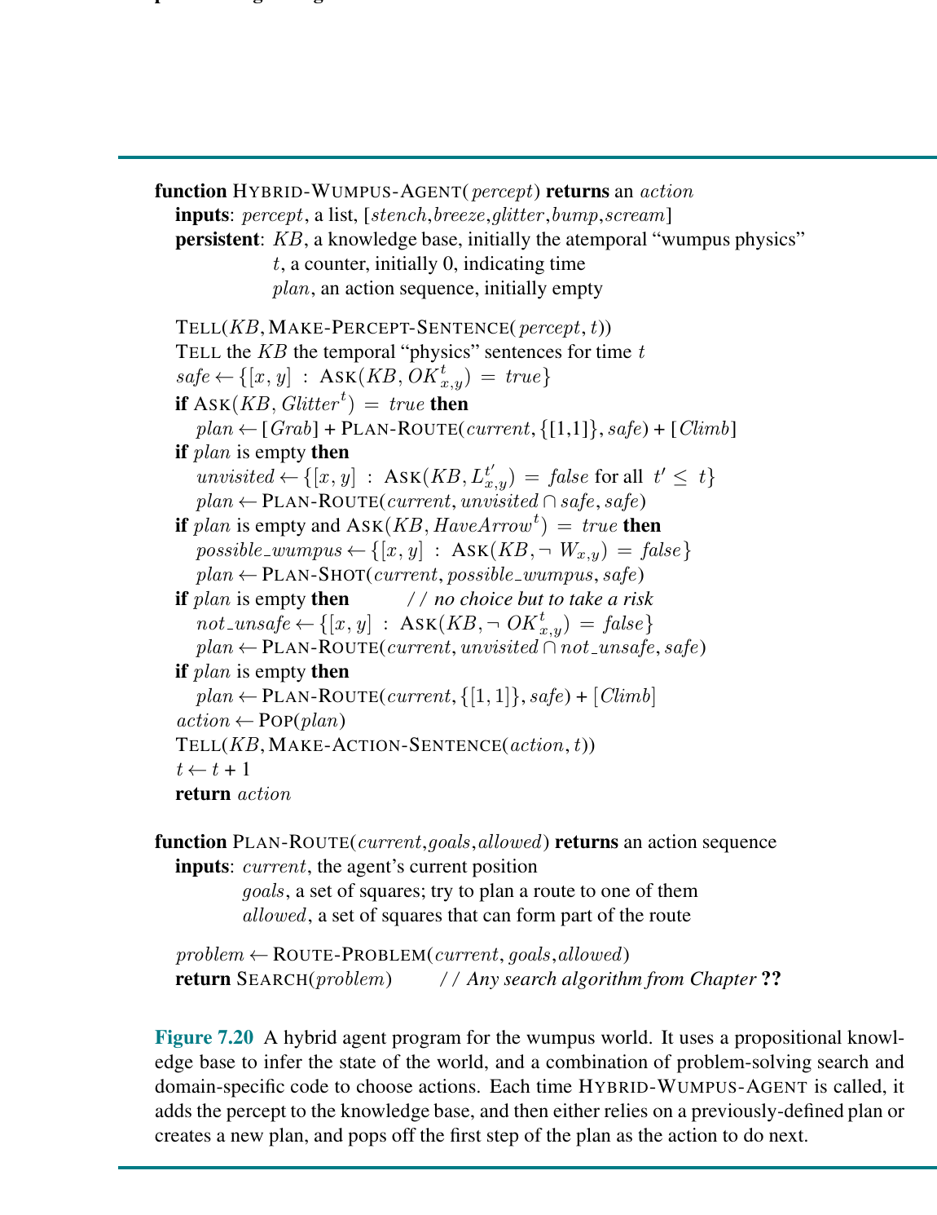
Figure 7.20: Hybrid Wumpus Agent
A logic-based agent with planning and action selection.
Update KB
Tell the KB percepts and time-indexed action facts.
Infer safety
Ask which squares are safe, visited, or hazardous.
Plan actions
Use search/planning to reach gold or safe unvisited squares.
Hybrid design
Chapter 7 Figure 7.20: Hybrid Wumpus agent program
Logic handles knowledge; search handles action sequences.
COMP 469 | Logical Agents
Chapter 7 Figures
72
Notes:
Do not read every line of the pseudocode. Show the architecture: update knowledge, infer facts, select or plan actions. Analogy: A chess player uses both knowledge (piece values, tactics) and search (lookahead). The Wumpus agent also combines reasoning and planning. Gotcha: A pure logic agent still needs action strategy. Proving facts alone does not automatically move the agent.

Slide 73
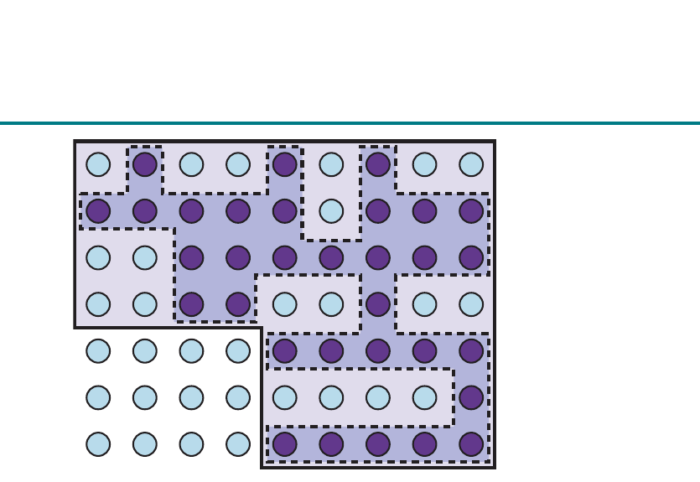
Figure 7.21: 1-CNF Belief State
A compact representation can still cover many possible worlds.
Belief state
Represents uncertainty over possible worlds.
Compact formula
Some belief sets can be represented concisely.
Many worlds
A small logical formula can stand for many states.
Limit
Chapter 7 Figure 7.21: 1-CNF belief state depiction
Not every belief state has a compact propositional form.
COMP 469 | Logical Agents
Chapter 7 Figures
73
Notes:
Use this slide to show why representation matters. A formula is often much smaller than an explicit list of states. Analogy: Saying "all students except seniors" is more compact than listing every eligible student. Gotcha: Compactness depends on structure. Some sets of states are inherently hard to express compactly in propositional logic.

Slide 74
Making Plans by Propositional Inference
Planning can be reduced to SAT.
Planning query
• Encode initial state
• Encode legal actions at each time
• Encode transition rules
• Encode the goal at final time
t=0
A0
t=1
A1
t=2
Encode
Solve
Extract
SAT solver answer
Initial state, actions, transition rules, goal
Ask SAT solver for a satisfying model
Read action sequence from model
• If satisfiable: extract action sequence from the model
• If unsatisfiable: try a longer horizon
• This is the idea behind SATPLAN
Planning becomes: is there a movie script that satisfies all rules?
COMP 469 | Logical Agents
Logical Planning
74
Notes:
Analogy: SATPLAN writes a movie script with rules: the opening scene is fixed, each scene must follow from previous scenes, and the final scene must show the goal. A SAT solver finds a script that works. Gotcha: SATPLAN usually searches by horizon length. Unsatisfiable at depth 3 does not mean no plan exists; it may require depth 4 or more.

Slide 75
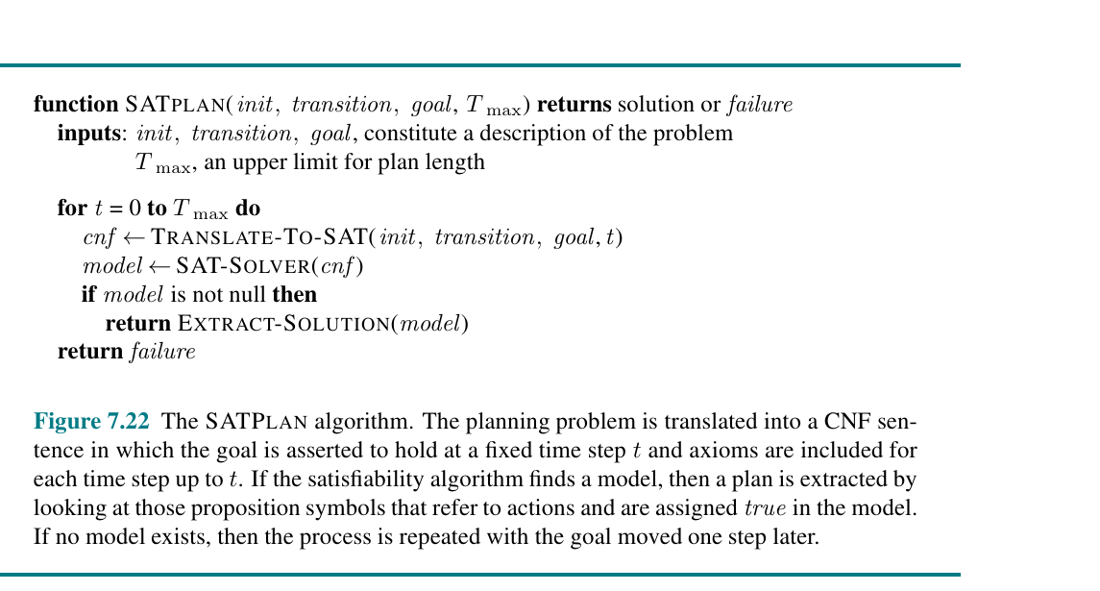
Figure 7.22: SATPLAN
Planning by increasing the time horizon until SAT succeeds.
Increment horizon
Try plans of length 0, 1, 2, ...
Translate to CNF
Each horizon becomes a SAT problem.
Extract solution
A satisfying model contains the action sequence.
Scope
Chapter 7 Figure 7.22: SATPLAN algorithm
Works best in fully observable or sensorless settings in this chapter.
COMP 469 | Logical Agents
Chapter 7 Figures
75
Notes:
Highlight the loop over time horizon. This is similar to iterative deepening, but each depth becomes a SAT problem. Analogy: "Can I finish the puzzle in 3 moves? No. In 4 moves? Yes. Here is the sequence." Gotcha: Do not confuse SATPLAN with a search tree algorithm like BFS. It delegates the constraint solving to SAT.

Slide 76
What Propositional Logic Cannot Do Well
Chapter 7 ends by motivating Chapter 8.
No variables
No objects/relations
Cannot say "for every square" directly.
P_1,2 is just a name; the logic does not understand coordinates.
Scaling problem
Next step
Need separate symbols and rules for many locations and times.
First-order logic adds objects, predicates, functions, and quantifiers.
COMP 469 | Logical Agents
Chapter 7
76
Notes:
Use the Wumpus rule: "Squares adjacent to pits are breezy." In propositional logic, this becomes many separate rules. In first-order logic, we can say it once with variables. Analogy: Propositional logic is like labeling every seat in a classroom individually. First-order logic can talk about "all seats" and "who sits next to whom." Gotcha: More expressive languages are not automatically easier. They can make reasoning harder even while making representation easier.

Slide 77
Bridge to Chapter 8: First-Order Logic
Why the course moves beyond propositional logic.
Propositional logic
First-order logic
• Good for finite sets of named facts
• Well-developed SAT algorithms
• Easy semantics with truth assignments
• Can become huge and repetitive
• Talks about objects and relations
• Uses variables and quantifiers
• Represents general patterns compactly
• Reasoning becomes more complex
Chapter 7 teaches the logic engine; Chapter 8 gives it a richer language.
Students should see this as a natural progression, not a new topic.
COMP 469 | Logical Agents
Chapter 7
77
Notes:
This is a preview. Keep it high level. Instructor prompt: Ask students how they would write "every adjacent pit causes a breeze" without writing one rule per square. Gotcha: Do not imply first-order logic replaces propositional logic. SAT solvers remain important and are widely used in practice.

Slide 78
Lab Connections for Chapter 7
How students will see these ideas in code.
Lab 7A
Lab 7B
Knowledge-based agent and Wumpus World reasoning.
Propositional logic and model checking.
Lab 7C
Lab 7D
CNF, resolution, and theorem proving.
Horn clauses, forward chaining, and backward chaining.
Lab 7E
DPLL, WalkSAT, SATPLAN, and propositional-logic limits.
COMP 469 | Logical Agents
Chapter 7
78
Notes:
Tie the lecture to your existing visual labs. This helps students understand that the lecture is not just theory; they will run code and see the inference steps. Gotcha: Students may treat lab notebooks as black boxes. Encourage them to modify one rule or one percept and observe what conclusions change.

Slide 79
Common Student Gotchas
A one-slide warning label before practice.
Unknown is not false
OR is inclusive
Not proving P is not the same as proving NOT P.
P OR Q allows both P and Q to be true.
Implication is formal
Entailment is semantic
P ⇒ Q is false only when P is true and Q is false.
KB ⊨ α means every KB model satisfies α.
SAT failure depends on solver
DPLL can prove unsat; WalkSAT failure may only mean no model found.
COMP 469 | Logical Agents
Chapter 7
79
Notes:
This slide is extremely useful before homework or a quiz. Instructor prompt: Ask students to pick one gotcha and invent a tiny example showing the mistake. Gotcha: The "unknown is not false" issue is the root of many Wumpus mistakes. Keep reinforcing it.

Slide 80
In-Class Quiz Questions
Quick checks for understanding.
Q1
Q2
If KB entails α, can α be false in a model where KB is true?
If WalkSAT fails after max flips, what can we conclude?
Q3
Q4
Why does no breeze at [1,1] prove no pit in [1,2]?
What is the difference between TELL and ASK?
COMP 469 | Logical Agents
Chapter 7
80
Notes:
Answers: Q1 no. Q2 only that WalkSAT did not find a model; not necessarily unsatisfiable. Q3 because the breeze rule links adjacent pits to breezes, and [1,2] is adjacent to [1,1]. Q4 TELL adds a sentence; ASK queries what follows. Use this as a low-stakes clicker or think-pair-share activity. Gotcha: For Q3, mention boundaries and the exact adjacent squares.

Slide 81
Suggested Teaching Plan: 75-90 Minutes
A practical pacing guide for class.
0-15 min
15-30 min
KB agents, TELL/ASK, and Wumpus setup.
Wumpus safety inference and student activity.
30-50 min
50-70 min
Syntax, semantics, models, entailment, truth tables.
Model checking, resolution, Horn clauses, chaining.
70-90 min
DPLL, WalkSAT, SATPLAN, gotchas, lab preview.
COMP 469 | Logical Agents
Chapter 7
81
Notes:
Instructor note: If time is short, prioritize entailment, Wumpus safety inference, and the distinction between model checking and theorem proving. If students are struggling with symbols, pause and return to the detective analogy. Optional extension: Have students trace a two-rule forward chaining example on the board.

Slide 82
Full Lecture Summary
The Chapter 7 mental model students should leave with.
1. Knowledge
2. Reasoning
A KB stores formal sentences that describe what the agent knows.
Inference derives what must follow from the KB.
3. Logic
4. Algorithms
Syntax builds sentences; semantics defines truth in models.
Model checking, resolution, chaining, DPLL, and WalkSAT answer logical queries.
5. Action
Logical agents use inferred knowledge to act safely and plan.
COMP 469 | Logical Agents
Chapter 7
82
Notes:
End with the core message: Chapter 7 is about turning perception into knowledge, knowledge into inference, and inference into action. Analogy recap: detective notebook, Minesweeper board, truth-table worlds, algebraic proof, and SAT movie script. Gotcha recap: unknown is not false; implication is formal; propositional logic is powerful but repetitive.

Slide 83
References and URLs
Resources for instructor preparation and student enrichment.
Textbook
AIMA Python code
Russell & Norvig, Artificial Intelligence: A Modern Approach, 4th ed.
https://aima.cs.berkeley.edu/
Logic code and notebooks for AIMA algorithms.
https://github.com/aimacode/aima-python
AIMA Logic notebook
Berkeley CS188
Interactive supporting notebook for logic chapters.
https://github.com/aimacode/aima-python/blob/master/logic.ipynb
Comparable intro AI course materials and logic topics.
https://www2.eecs.berkeley.edu/Courses/CS188/
PySAT toolkit
SATLIB benchmarks
Python toolkit for SAT-based prototyping.
https://pysathq.github.io/
SAT benchmark problems and DIMACS references.
https://www.cs.ubc.ca/~hoos/SATLIB/benchm.html
COMP 469 | Logical Agents
Chapter 7
83
Notes:
Use these references if students want code or outside explanations. AIMA Python is especially helpful for seeing algorithms implemented. Instructor note: Remind students that internet examples may use slightly different chapter numbering or notation. The concepts are the same, but your course slides and labs define the expected vocabulary. Gotcha: Do not assign too many external readings at once; logic already has heavy notation.

Slide 84
Closing Slide: What Comes Next?
Prepare students for Chapter 8 and first-order logic.
Today
Next
Big payoff
Named propositions and propositional inference.
Objects, predicates, functions, variables, and quantifiers.
Represent general statements compactly, such as "all adjacent pits cause breezes."
COMP 469 | Logical Agents
Chapter 7
84
Notes:
Close with encouragement: propositional logic is the training ground. Students have now learned the ideas that recur in richer logics. Ask students to bring one real-world rule to the next class that would be awkward in propositional logic but natural with variables and "for all." End with the phrase: "In Chapter 7, the agent learned to reason. In Chapter 8, it learns to talk about objects."

